Slide 1

Organizational Behavior
(MGT-502)
Lecture-33

Slide 2
Summary of
Lecture-32

Slide 3
Elements of the Environment
Technology
Political/Legal
The Organization
Sociocultural
Economic

Slide 4

Work Design and Technology

Slide 5
Technology in the Workplace
Continuous Improvement Processes
  Good isn’t good enough
  Focus is on constantly reducing the variability in the organizational processes to produce more uniform products and services.
    Lowers costs and raises quality.
    Increases customer satisfaction.
  Organizational impact
    Additional stress on employees to constantly excel.
    Requires constant change in organization.

Slide 6
Process Reengineering
Rethinking and redesigning the processes by which the organization creates value and does work, ridding itself of operations that have become antiquated.

Slide 7

What’s an e-Organization?
A profit or nonprofit organization that uses the Internet and private network links to facilitate activities and communication

Slide 8
Today’s Topics

Slide 9
Work Design and Technology

Slide 10
Work Space Design
Size
  The trend is away from traditional allocation of space based on organizational statue towards a flexible open space design that accommodates group and team activities.
Arrangement
  Open arrangements foster social interaction and influence the formality of relationships
Privacy
  Individual employee needs for workplace privacy are largely a function of the type of work that the employee does (e.g., programmers, HR managers, receptionists).

Slide 11
Work Space Design (cont’d)
Feng Shui
  Designing work surroundings so the “Chi” or life force of the space is in harmony and balance with nature. (Office location and layout, Desk position, Water, Plants and flowers, Reflection)
Workspace Design and Productivity
  Workspaces alone don’t provide substantial motivation.
  Workspaces make it easier for employees to perform behaviors that make them more effective.

Slide 12
Work Redesign Options
Job Rotation: The periodic shifting of a worker from one task to another.
Job Enlargement: The horizontal expansion of jobs.
Job Enrichment: The vertical expansion of jobs.

Slide 13
Work Redesign Options (cont’d)
Team-Based Work Designs Revisited
  The Job Characteristics Model (JCM) predicts high performance of groups when:
    Group members use a variety of high level skills.
    Outcomes of the group’s work has significant consequences for other people.
    The group has substantial autonomy in deciding how they do the work.
    Work on the task generates regular, trustworthy feedback.

Slide 14
Work Schedule Options
Flextime: Employees work during a common core time period each day but have discretion in forming their total workday from a flexible set of hours outside the core.
Job Sharing: The practice of having two or more people split a 40-hour-a-week job.
Telecommuting: Employees do their work at home on a computer that is linked to their office.

Slide 15
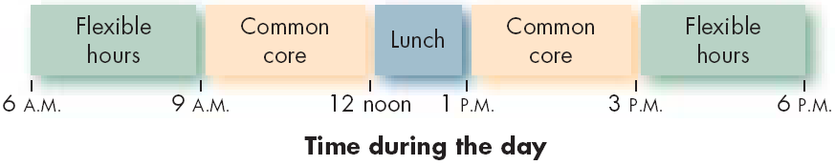
Example of a Flextime Schedule

Slide 16
Telecommuting
Advantages
  Larger labor pool
  Higher productivity
  Less turnover
  Improved morale
  Reduced office-space costs
Disadvantages (Employer)
  Less direct supervision of employees
  Difficult to coordinate teamwork
  Difficult to evaluate non-quantitative performance

Slide 17
Human Resource Policies and Practices

Slide 18
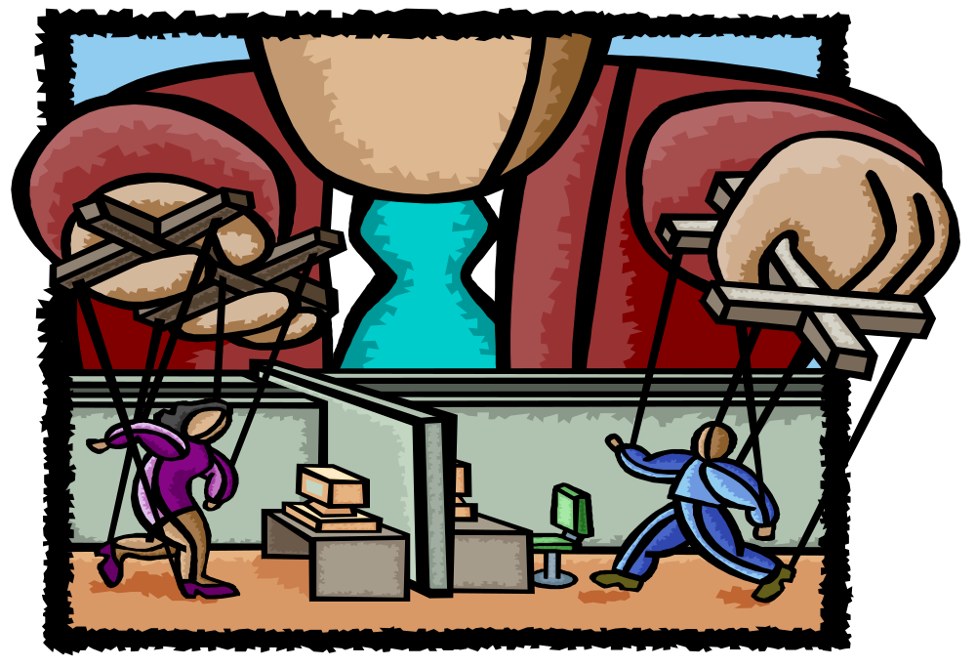

Slide 19

HRM Definition
Staff or support function
Managing the People

Slide 20
Human Resource Management
Managerial function that tries to match an organization’s needs to the skills and abilities of its employees.

Slide 21

HRM Activities
Getting people
Preparing people
Stimulating people
Keeping people

Slide 22

Staffing (Get)
Strategic human resource planning
Recruiting
Selection

Slide 23
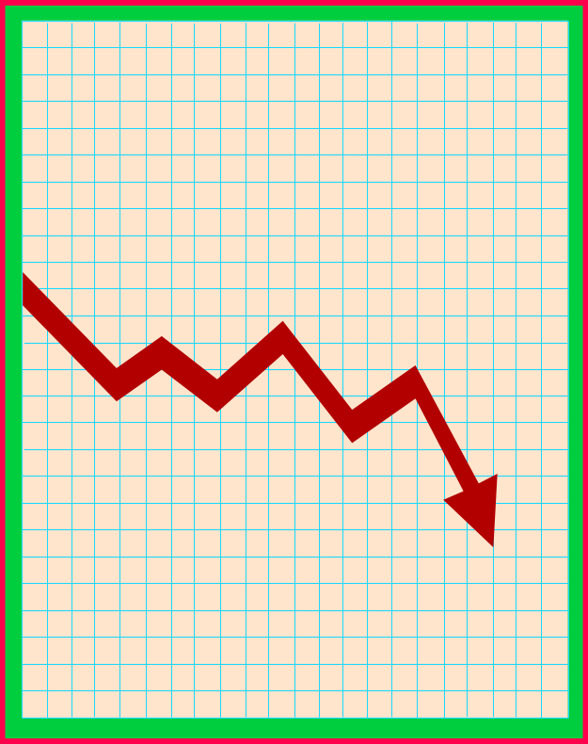
Staffing Activities
Employment planning
  Strategic goals and objectives
  Job requirements change
Job analysis
  Job description
  Job skills
Recruiting
Selection

Slide 24

Training And Development (Prepare)
Orientation
Training
Development
  Employee
  Career
  Organization

Slide 25

Training and Development Goals
Adapt to new surroundings
Cope with change
Meet organizational needs

Slide 26

Motivation (Stimulate)
Job design
Performance appraisals
Rewards and compensation
Employee benefits

Slide 27

Motivation Goal
Competent and adapted employees
With up-to-date skills, knowledge, abilities
Exerting high energy levels

Slide 28

Motivation
Implications
  Individual
  Managerial
  Organizational
Performance
  Willingness
  Ability
Respect

Slide 29

Maintenance (Keep)
Health and safety
Communications
Employee relations

Slide 30

Maintenance
Health
Safety
Communications
Employee assistance programs
Environment where employee voices are heard

Slide 31

What is Human Resource Management?
Conducting job analysis
Planning labor needs
Selecting job candidates
Orienting and training new employees
Managing wages and salaries
Providing incentives and benefits
Appraising performance
Communicating
Training and developing
Building employee commitment

Slide 32
Why Is HR Management Important to All Managers?
Helps you avoid common personnel mistakes:
  Hiring the wrong person for the job
  Experiencing high turnover
  Finding your people not doing their best
  Wasting time with useless interviews
  Having your company taken to court because of your discriminatory actions
  Having your company cited for bad reputation

Slide 33
Helps you ensure you get results - through others.

Slide 34
National Culture
Political Forces Economic System
Human Resource
System
Policies / Procedures
Recruitment
Selection
Motivation/Reward System
Management Style
Training
Career Paths
Corporate
Culture
Labour Traditions
Legal Forces

Slide 35
The Organization
Productivity
Profits
Survival
Stockholders &
Investors
Shareholders return
Return on sales
Return on
investments
Strategic Partners
Suppliers
Unions
Customers
HRM
Customers
Quality service
Quality Products
Speed &
Responsiveness
Low cost
Innovation
Society
Legal compliance
Social
responsibility
Ethical management
Employees
Fair treatment
Satisfaction
Empowerment
Safety & Health

Slide 36

Managing Human Resources for This Era
Organizational ability
To Attract
To Develop
To Motivate and
To Keep talented people

Slide 37

Successful HRM
Organization: High level of profitability, Higher annual sales per employee, High market value.
Employee: More employment security, More job opportunities, High wages.
Society: Elevating the standard of living, Strengthening ethical guidelines.

Slide 38
Job analysis

Slide 39
Job Analysis is the SYSTEMATIC process of collecting and making judgments about all the important information related to a job.
Notes:
6

Slide 40
Equal
Employment
HR
Planning
Recruitment
Selection
HR
Research
HR
Development
Job Analysis
Employee
& Labor
Relations
Safety &
Health
Compensation
& Benefits
Performance
Appraisal

Slide 41
Job analysis outcomes

Slide 42
Job description
Job specification
Job evaluation

Slide 43

Let’s stop it here

Slide 44
Summary

Slide 45
Human Resource Policies and Practices

Slide 46
HRM Activities
Getting people
Preparing people
Stimulating people
Keeping people

Slide 47
Managing Human Resources for This Era
Organizational ability
To Attract
To Develop
To Motivate and
To Keep talented people

Slide 48
Job analysis

Slide 49
Equal
Employment
HR
Planning
Recruitment
Selection
HR
Research
HR
Development
Job Analysis
Employee
& Labor
Relations
Safety &
Health
Compensation
& Benefits
Performance
Appraisal

Slide 50
Job analysis outcomes

Slide 51
Job description
Job specification
Job evaluation

Slide 52
Next….

Slide 53
Human Resource Policies and Practices (Cont…)

Slide 54
Organizational Behavior
(MGT-502)
Lecture-33

